Slide 1
DISSERTATION – First draft
Kim López Güell
Daniel Prieto-Alhambra
University of Oxford, 2021-2022

Slide 2
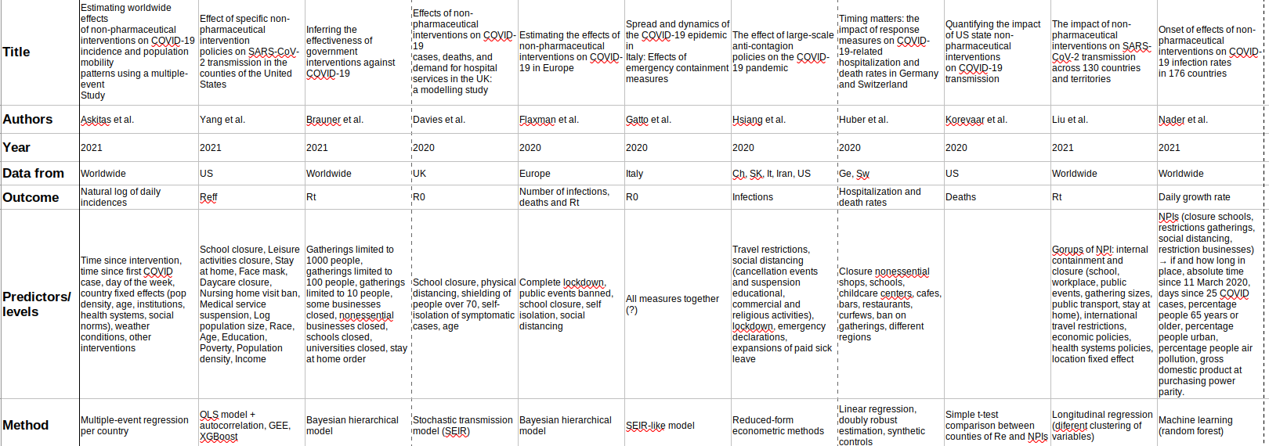
What has been done until now?
Similar papers I found. What they did not do:
- Stratify by age and sex (some did have age data, but only regional analyses)
- Consider COVID passport as one of the NPIs

Slide 3
What can we do?
Stratifying by age and sex might be interesting and novel. Data available:
ECPC on weekly new cases of 30 Europe countries by 15yr age groups, from 2020-01
INE on weekly deaths of Spain (national and regional) by 5yr age groups and sex, from 2019-01
Considering the effect of COVID passport is also feasible.

Slide 4
Therefore, first possibility:
Outcome: New cases (possibly log-scaled)
Methods: ARIMAX and joinpoint regression
Stratifying/covariates: Age (15yr groups), country effects (30)

Slide 5
Otherwise, second possibility:
Outcome: Deaths (possibly log-scaled)
Methods: ARIMAX and joinpoint regression
Stratifying/covariates: Age (5yr groups), regional effects (19), sex

Slide 6
Questions
I would like to consider other NPIs as well. There is the problem of multicollinearity but we could work that out (intensity idea, different covariate regression comparison, etc.). But: as far as I know joinpoint regression and ARIMAX don’t allow for multiple covariates. Stratifying by sex and age only requires applying the method to different blocks of data, but this would be different. How could we overcome it?
We could do both analyses, as the main methods would be the same. It might be interesting as well to compare Spanish outcomes from both data sets. If I have got time I can do so, yet I should pick one of both studies to begin with. Maybe the first one, as it is more global, is more relevant? R:[14:08] Daniel Prieto Alhambra

